Slide 1
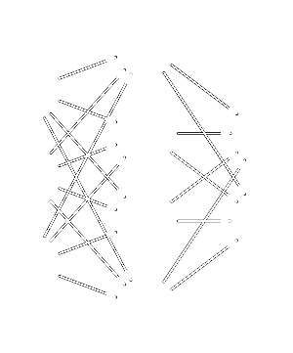
Neural Network

Slide 2
This Lesson
Classic Neural Network
Handwritten digits recognition

Slide 3
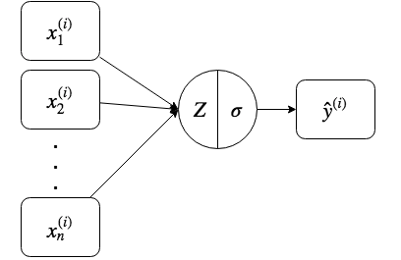
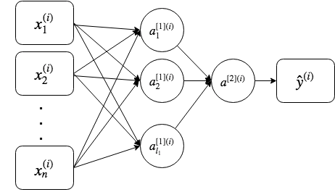
Neural Network vs Logistic Regression
Logistic Regression Neural Network
X.shape = (n, m) index [l] corresponds to layer number l = (1,L)
index (i) corresponds to sample number i = (1,m)
For linear regression:

Slide 4
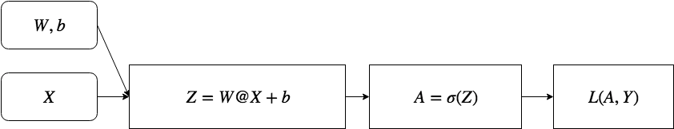
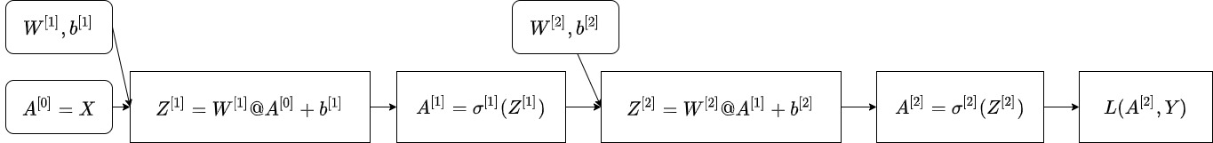
Neural Network vs Logistic Regression
Logistic Regression
Neural Network
For linear regression:

Slide 5
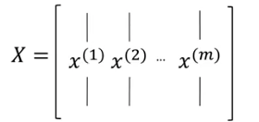
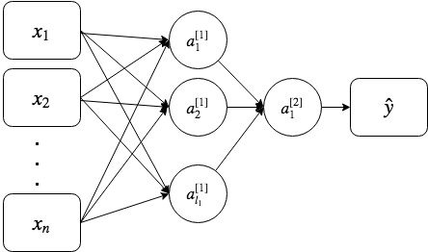
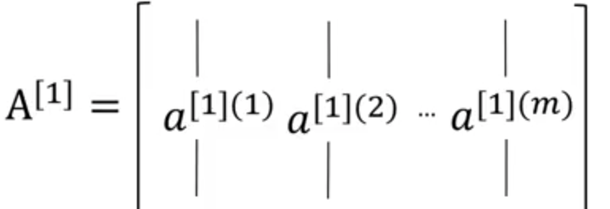
Shallow Neural Network
For all samples
For linear regression:

Slide 6
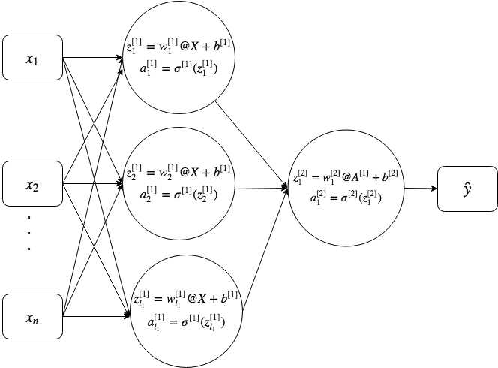
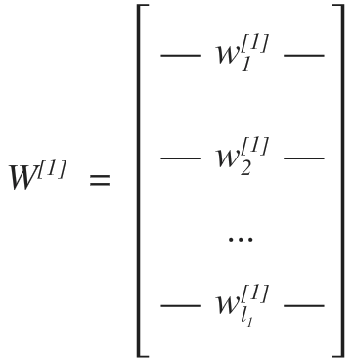
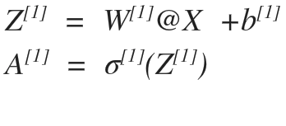
2-Layers Neural Network
For linear regression:

Slide 7

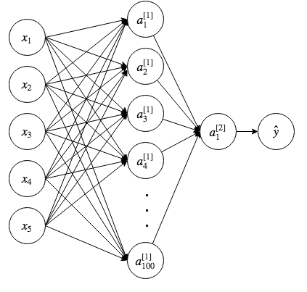
Shapes Sample
For linear regression:

Slide 8
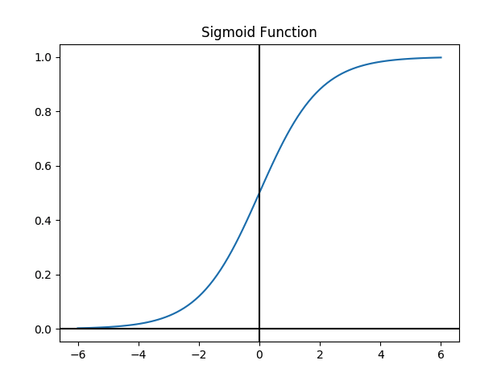
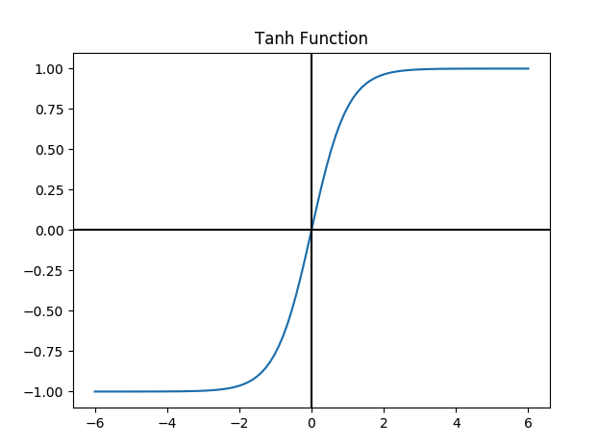
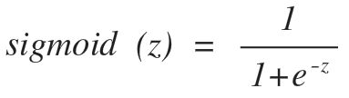
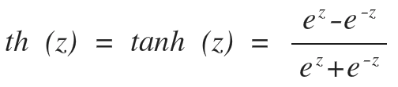
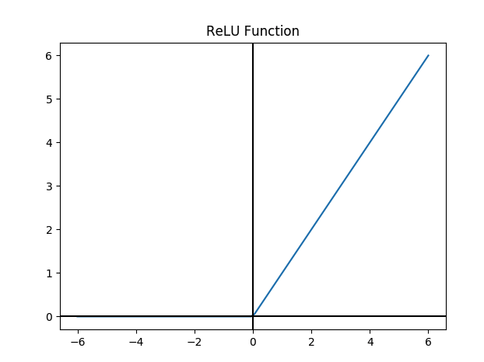
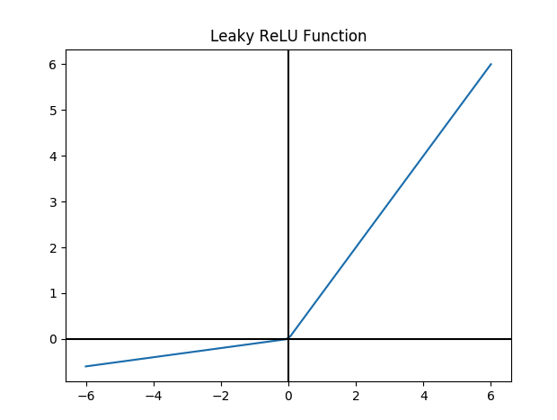

Activation Functions
Rectified Linear Unit
For linear regression:
Notes:
Tanh works better than sigmoid unless output layer where you need value between 0 and 1
ReLU is faster for learning and gives almost the same results as tanh
Leaky ReLU is slightly better than ReLu but used less in practice

Slide 9
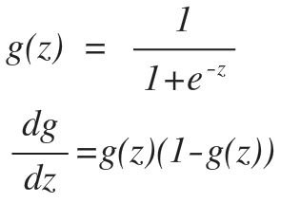
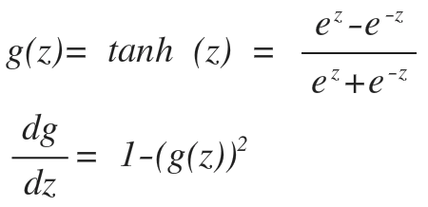
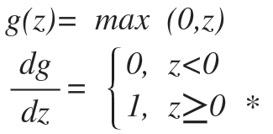
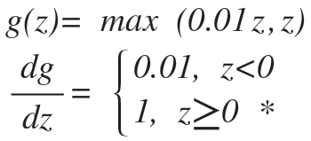
Derivatives Of Activation Functions
SIgmoid
Tanh
ReLU
Leaky ReLU
For linear regression:
Notes:
Tanh works better than sigmoid unless output layer where you need value between 0 and 1
ReLU is faster for learning and gives almost the same results as tanh
Leaky ReLU is slightly better than ReLu but used less in practice

Slide 10
Two-Layer Model
Init parameters
W1 = np.random.randn(n_h, n_x)*0.01
b1 = np.zeros(shape=(n_h, 1))
W2 = np.random.randn(n_y, n_h) *0.01
b2 = np.zeros(shape=(n_y, 1))
Backward Propagation
dJ_Z2 = A2-Y
dJ_W2 = 1/m * dJ_Z2 @ A1.T
dJ_b2 = 1/m * np.sum(dJ_Z2, axis=1, keepdims= True)
dJ_Z1 = W2.T @ dJ_Z2 * (1 - A1**2)
dJ_W1 = 1/m * dJ_Z1 @ X.T
dJ_b1 = 1/m * np.sum(dJ_Z1, axis=1, keepdims= True)
Cache
Forward Propagation
Z1 = W1 @ X + b1
A1 = np.tanh(Z1)
Z2 = W2 @ A1 + b2
A2 = sigmoid(Z2)
loss = Y * np.log(A2) + (1-Y) * np.log(1-A2)
cost = -1/m* np.sum(loss)
Update parameters
W1 = W1 - learning_rate * dW1
b1 = b1 - learning_rate * db1
W2 = W2 - learning_rate * dW2
b2 = b2 - learning_rate * db2
Predict
predictions = A2 > 0.5
Notes:
Tanh works better than sigmoid unless output layer where you need value between 0 and 1
ReLU is faster for learning and gives almost the same results as tanh
Leaky ReLU is slightly better than ReLu but used less in practice

Slide 11
Sklearn Implementation
from sklearn.neural_network import MLPClassifier
clf= MLPClassifier(
solver= 'lbfgs',
random_state=20,
hidden_layer_sizes=(20,7,10),
# alpha=.1,
max_iter=30,
)
clf.fit(X_train_scaled,Y_train)
print("train accuracy= {:.3%}".format(clf.score (X_train_scaled, Y_train)))
print("test accuracy= {:.3%}".format(clf.score (X_test_scaled, Y_test)))

Slide 12
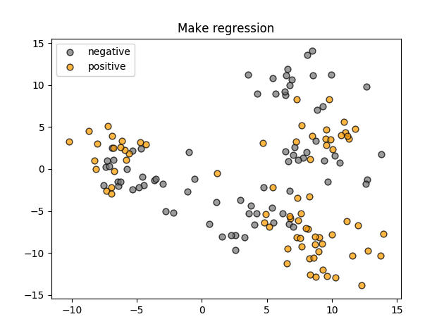
Synthetic Data
X_mk8, y_mk8 = make_blobs(
n_samples = 200,
n_features = 2,
centers = 8,
cluster_std = 2,
random_state = 4
)
Y_train = y_mk8 % 2

Slide 13
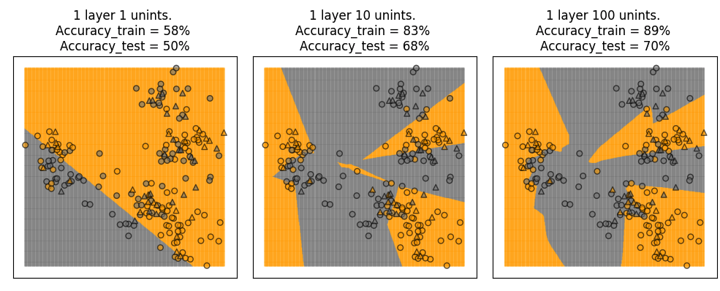
Single Hidden Layer

Slide 14
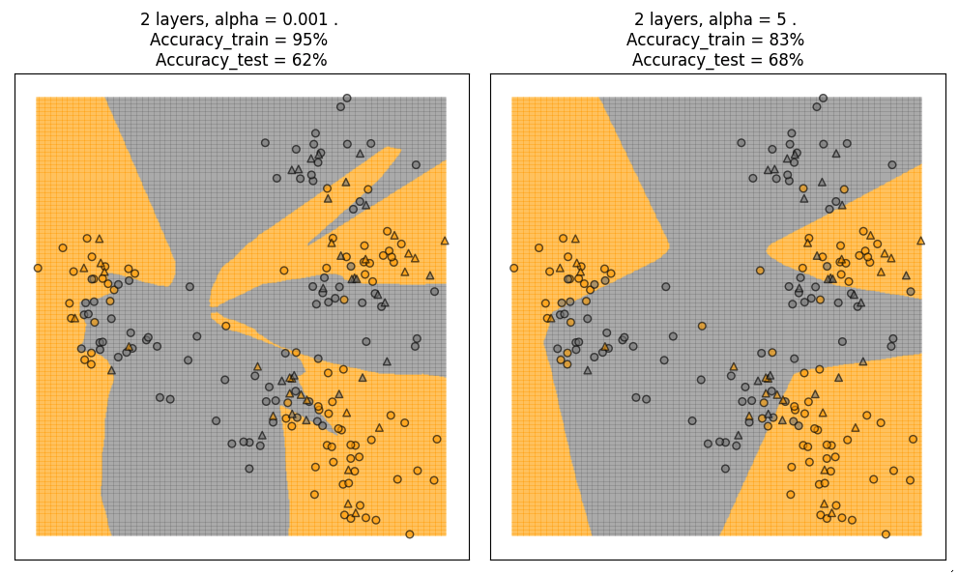
Regularization

Slide 15
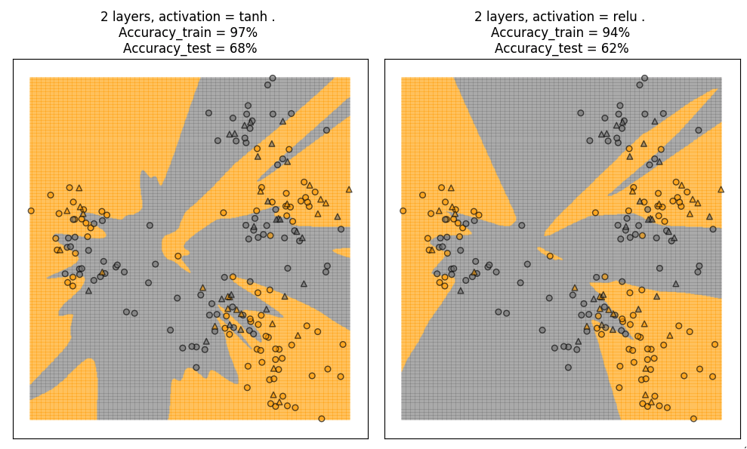
Activation Functions

Slide 16
Parameters
clf= MLPClassifier(
solver= 'lbfgs', # {‘lbfgs’, ‘sgd’, ‘adam’}, default ‘adam’
hidden_layer_sizes=(20,7,10), # default (100)
activation = ‘tanh’, # {‘identity’, ‘logistic’, ‘tanh’, ‘relu’}, default ‘relu’
alpha=0.1, # default 0.0001 - The larger alpha the stronger regularization
max_iter=30, # default 200
random_state=0, # default None
)

Slide 17
Pros and Cons
Pros
Captures complex decision boundaries
Can be used in regression
Cons
Require more data
Require more time for training
Require careful data preprocessing
Require model tuning

Slide 18
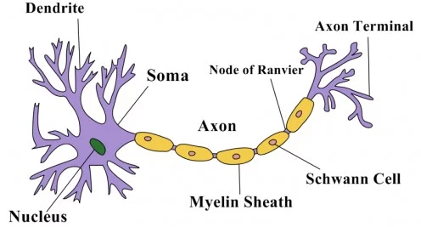
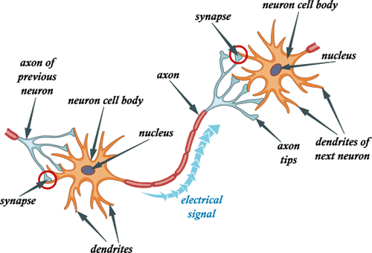
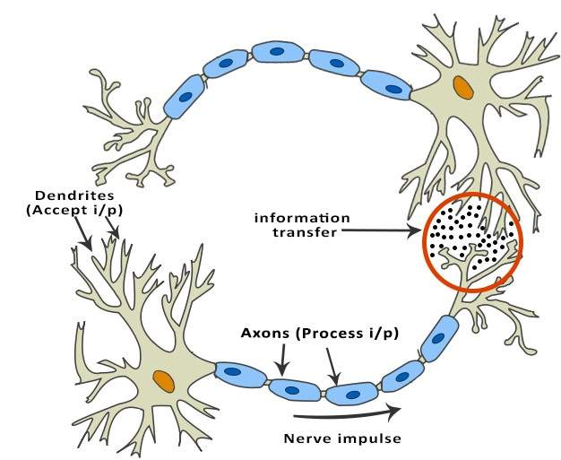
Neurons
For linear regression:

Slide 19
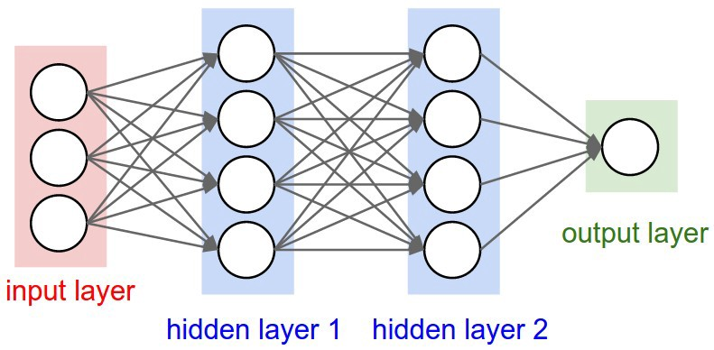
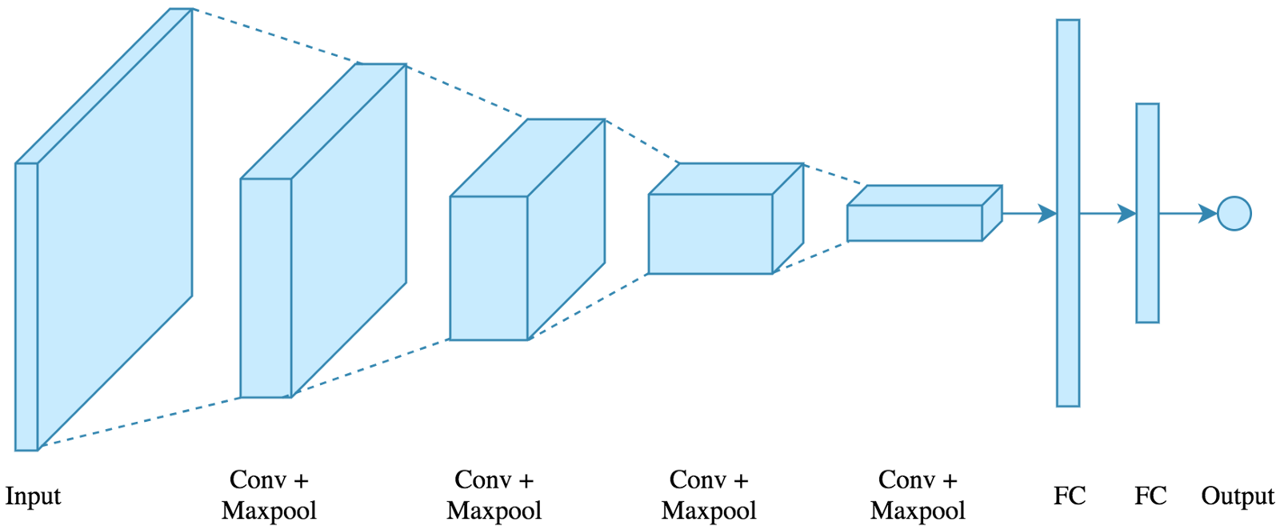

Neural Networks Types
Standard NN
Convolutional NN
Recurrent NN
For linear regression:

Slide 20

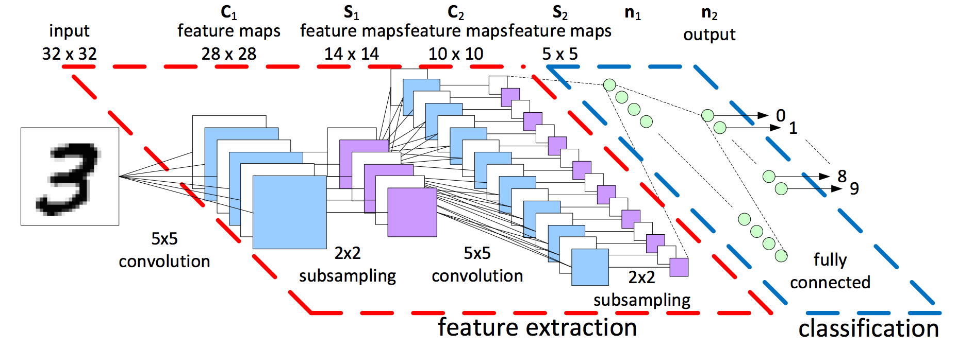
Feature Extraction
For linear regression:

Slide 21
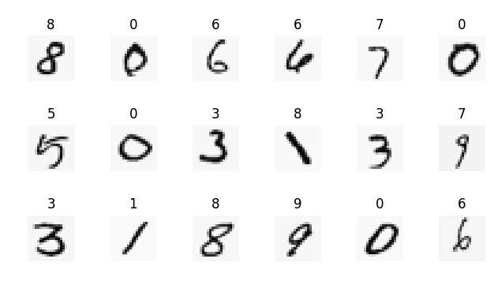
Handwritten Digits Sample

Slide 22
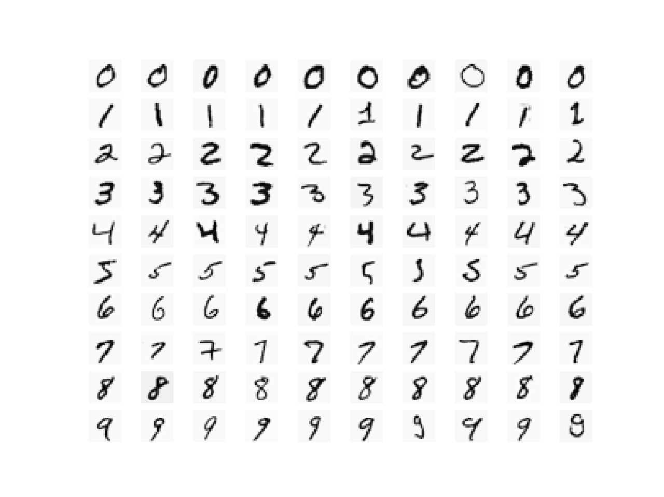
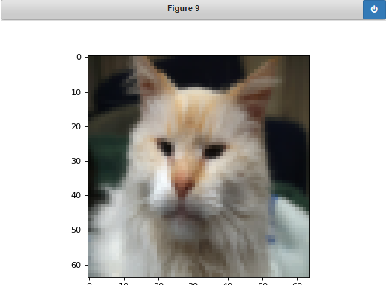
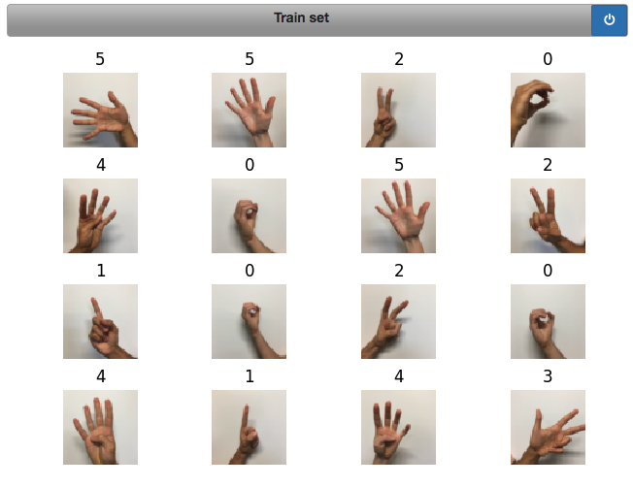
Home Task Classify data with 1-layer, 2-layers and 3-layers MLP
Use Handwritten Digits
data set Use the “Cat vs Noncat” data set Use the Signs data set

Slide 23
Learn more
Applied Machine Learning in Python
https://www.coursera.org/learn/python-machine-learning
Neural Networks and Deep Learning
https://www.coursera.org/learn/neural-networks-deep-learning
Limited-memory BFGS
https://en.wikipedia.org/wiki/Limited-memory_BFGS
sklearn.neural_network.MLPClassifier
https://scikit-learn.org/stable/modules/generated/sklearn.neural_network.MLPClassifier.html
Deep Learning in a Nutshell: Core Concepts
https://devblogs.nvidia.com/deep-learning-nutshell-core-concepts/
Notes:
All home task text is provided in handouts

Slide 24

THANKS!
Any questions?

